Slide 1
LightFlow : Speeding Up GPU-based Flow Switching and Facilitating Maintenance of Flow Table
Author : Nobutaka Matsumoto and Michiaki Hayashi
Conference: High Performance Switching and Routing (HPSR), 2012 IEEE 13th International Conference on
Presenter: Tung-yin Chi
Date: 2015/9/23
Department of Computer Science and Information Engineering
National Cheng Kung University, Taiwan R.O.C.
Notes:
1

Slide 2
Introduction
In this paper, LightFlow, a mechanism to accelerate software flow switching processing and relieve the burden of maintaining the flow table is proposed
LightFlow introduces two techniques:
acceleration mechanism for looking up the wildcard-aware table
automatic updating of the hash-based exact match table.

Slide 3
Introduction
The wildcard-aware flow table lookup is designed on a GPU-accelerated platform incorporating two dimensional parallelized lookup of the entries.

Slide 4
The Existing Issues In Handling Flow Tables
Lookup Time of Flow Entry
Maintenance of Flow Table

Slide 5
Lookup Time of Flow Entry

Slide 6
Maintenance of Flow Table
In conventional flow switches, flow tables require manual or semi-automatic update to reflect operators’ control policy.

Slide 7
Basic Idea of LightFlow (1)
To avoid manual configuration for all the exact entries, automatic update of the hash-based exact match table is introduced.
The addition of entries is based on the matching result of the wildcard-aware table, and the deletion of entries is based on periodic monitoring.

Slide 8
Basic Idea of LightFlow (2)
To accelerate lookup on the wildcard-aware flow table, a GPU-accelerated two-dimensional lookup mechanism for linear search is introduced.

Slide 9
Functional Architecture

Slide 10
Two-Dimensional Parallelization Method for Acceleration of Wildcard-Aware Flow Table Lookup

Slide 11
Automatic Update of Hash-based Exact Match Table

Slide 12
Environmental Setup

Slide 13
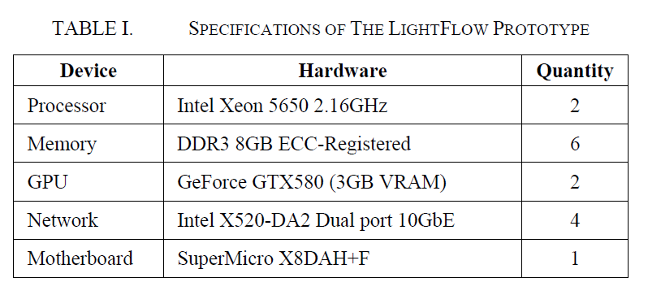
Environmental Setup
CentOS 6.2 (Linux kernel 2.6.32)
CUDA driver version used was 270.41.19.

Slide 14
Table Lookup Performance

Slide 15
Table Lookup Performance

Slide 16
Memory usage

